Slide 1
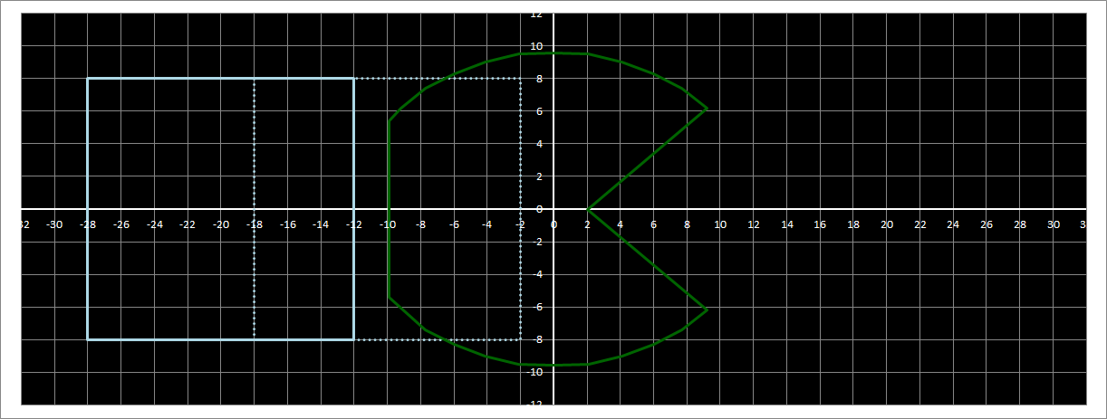
Snake body segment[0] (hidden) coordinates: (-10, 0)
Snake body segment[1] (visible) coordinates: (-20, 0)
Snake head coordinates: (0, 0)
Press RIGHT arrow
snake_head.direction = ‘right’
snake_head x coordinate increases by 10
Snake body segment[1] turtle (blue line)
Snake head turtle (green line)
Snake body segment[0] turtle (dashed line) hidden

Slide 2
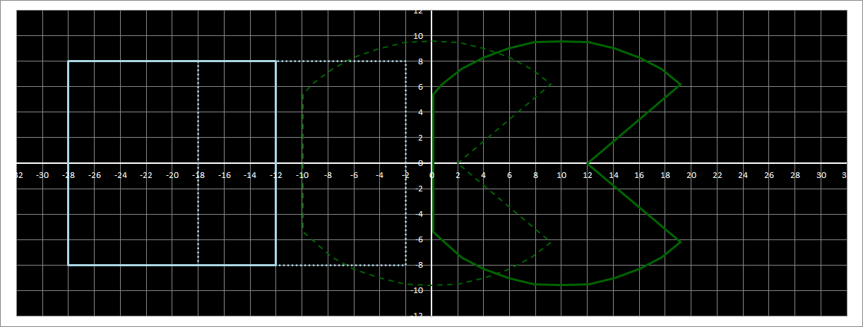
Snake body segment[0] (hidden) coordinates: (-10, 0)
Snake body segment[1] (visible) coordinates: (-20, 0)
Snake head coordinates: (10, 0)
Snake body segment[1] turtle (blue line)
Snake head turtle (green line)
Snake body segment[0] turtle (dashed line) hidden

Slide 3
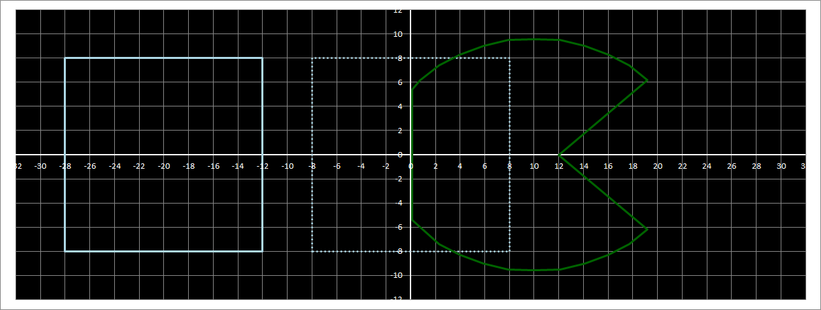
Snake body segment[0] (hidden) coordinates: (-0, 0)
Snake body segment[1] (visible) coordinates: (-20, 0)
Snake head coordinates: (10, 0)
Snake body segment[1] turtle (blue line)
Snake head turtle (green line)
Snake body segment[0] turtle (dashed line) hidden

Slide 4
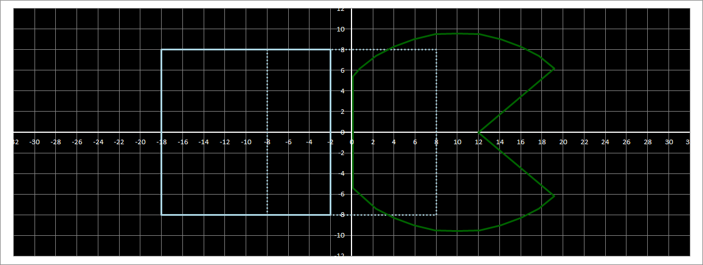
Snake body segment[0] (hidden) coordinates: (-0, 0)
Snake body segment[1] (visible) coordinates: (-10, 0)
Snake head coordinates: (10, 0)
Snake body segment[1] turtle (blue line)
Snake head turtle (green line)
Snake body segment[0] turtle (dashed line) hidden

Slide 5
Move the snake head, but remember what its last coordinates were
Move the first snake body segment to the coordinates where the snake head was
Move the second snake body segment to the coordinates where the first snake body segment was
if there are more than two segments: move the third snake body segment to the coordinates where the second snake body segment was, etc, etc...
We do this using a loop and the list of snake segments.

